Slide 1
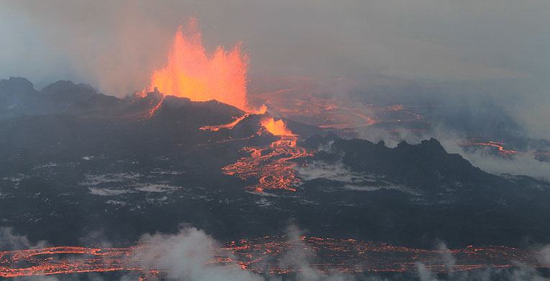
Tectono-magmatism in the Icelandic rift zones
and the Bárðarbunga-Nornahraun example
Photo: P. Hartree, Reykjavik
Information mainly from: http://en.vedur.is/ and http://en.vedur.is/earthquakes-and-volcanism/articles/nr/2947
See also:
Trønnes (2014): The Bárðarbunga-Nornahraun eruption, Iceland − an ongoing demonstration of rifting and volcanism, Forskning.no and ScienceNordic,
http://forskning.no/blogg/reidar-tronnes/bardarbunga-nornahraun-eruption-ongoing-demonstration-rifting-and-volcanism

Slide 2
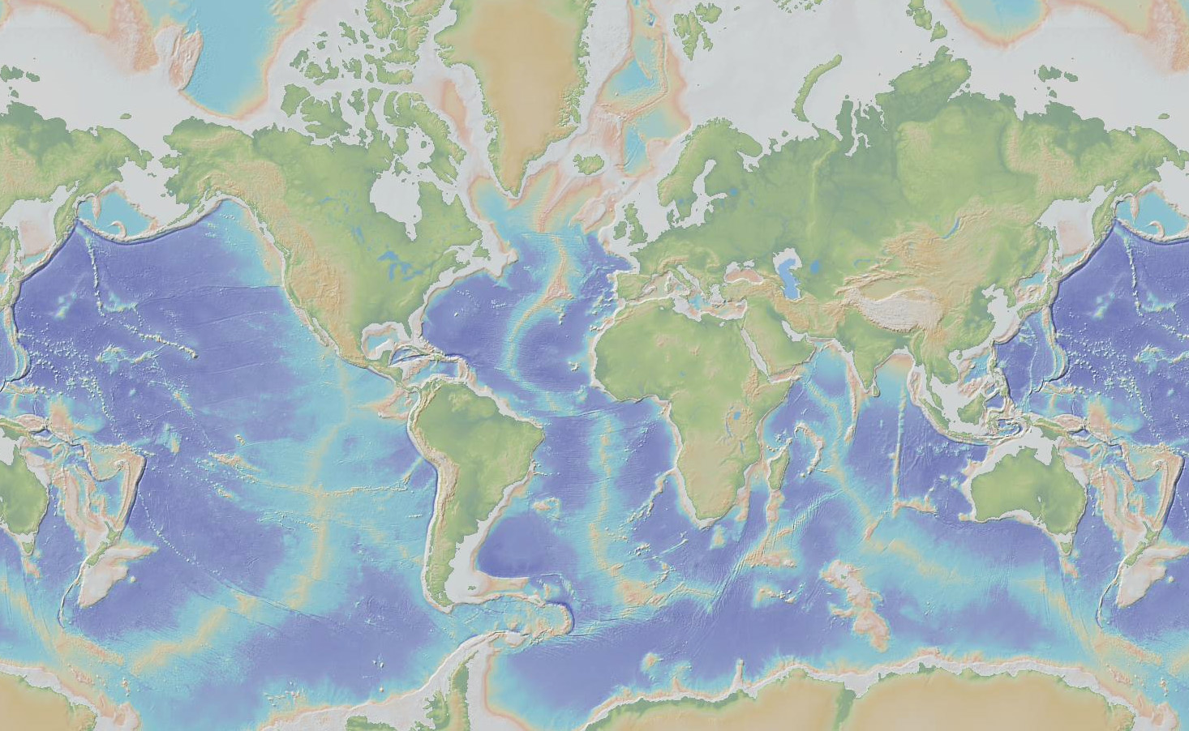
Iceland plume
- interacts with the MAR-system − makes it difficult to estimate plume flux
- Earth’s largest plume, 5-10 times the flux of the Hawaii plume (Jones et al. 2014, EPSL),
based on the size and crustal thickness of the Iceland plateau and distribution of V-shaped ridges

Slide 3
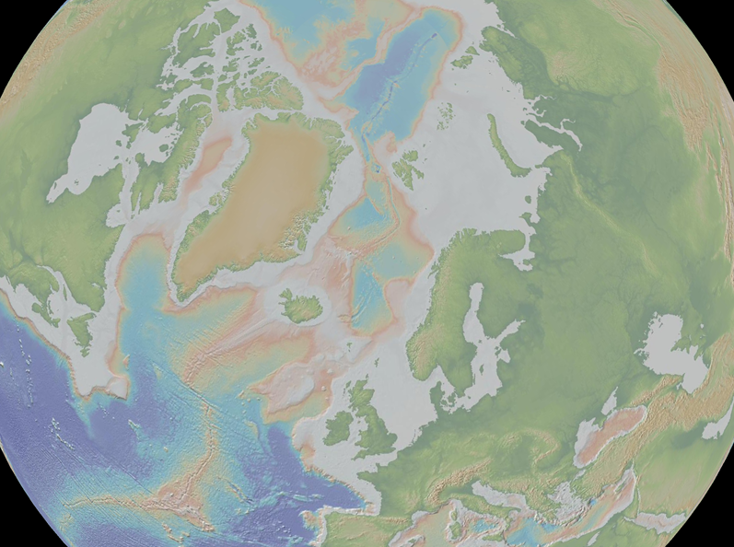
JM FZ
Exceptionally thick oceanic crust
Melting and volcanic productivity is modulated by:
- Episodic plume flux, resulting in V-shaped ridges
- Glacio-isotatic cycles
decompression melting under Iceland is extremely
sensitive to incremental pressure variations caused by
ice loading and deloading.
Gibbs FZ

Slide 4
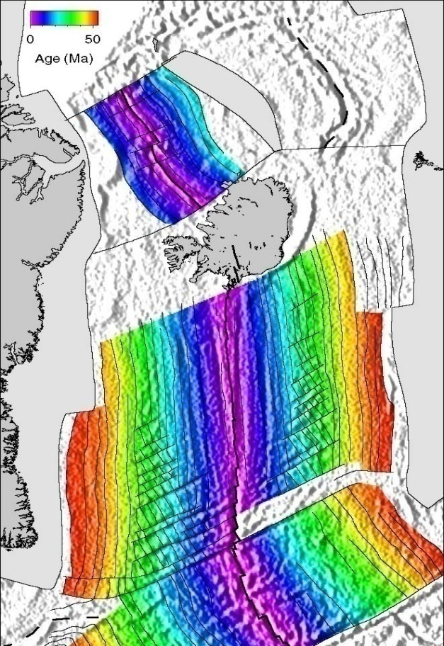
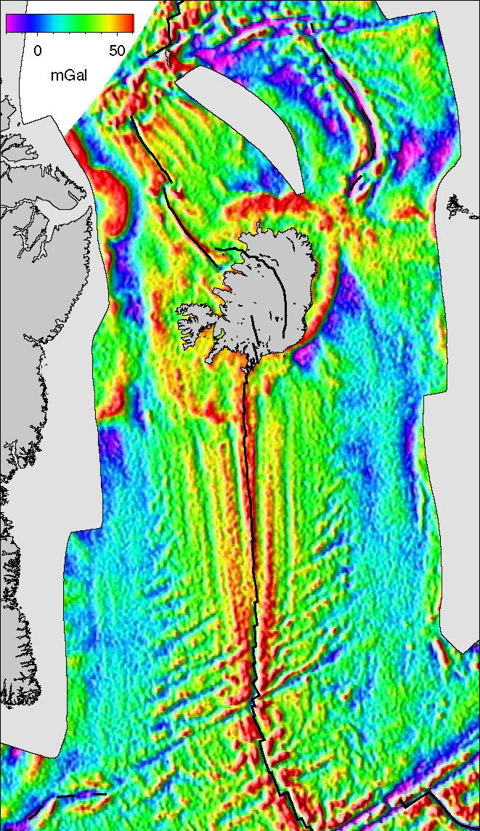
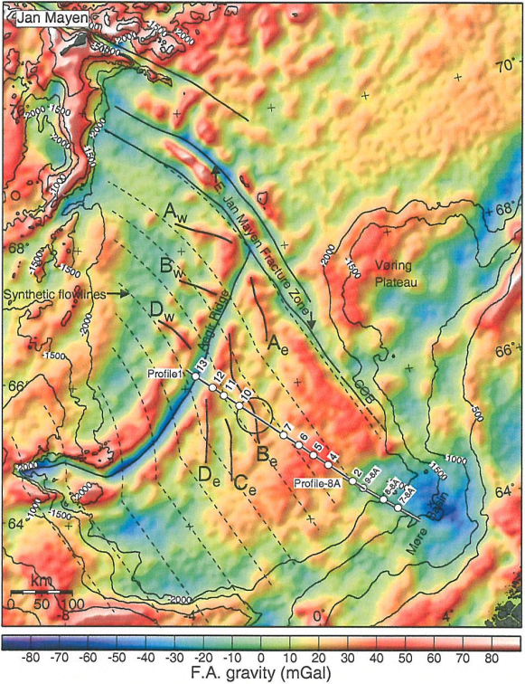
Evidence for laterally deflected and episodic plume flow from Iceland
V-shaped ridges: extending radially for about 1000 km
Breivik et al. (2006, JGR)
Jones et al. (2002, GGG)

Slide 5
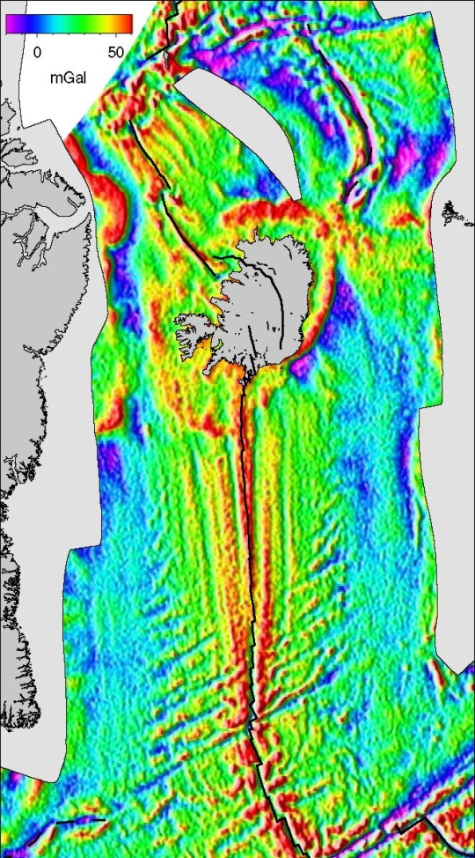
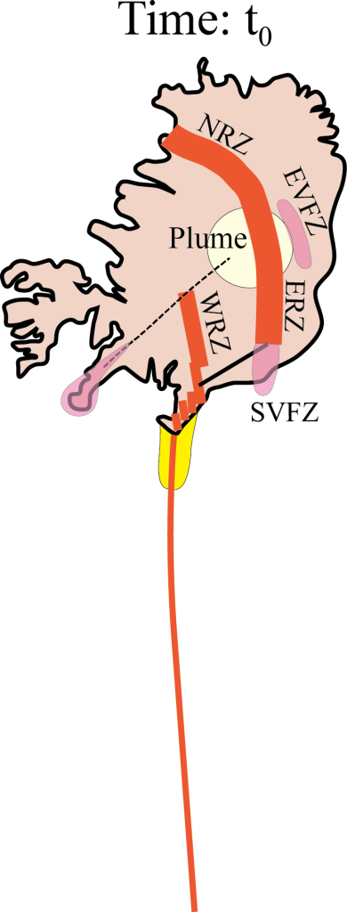
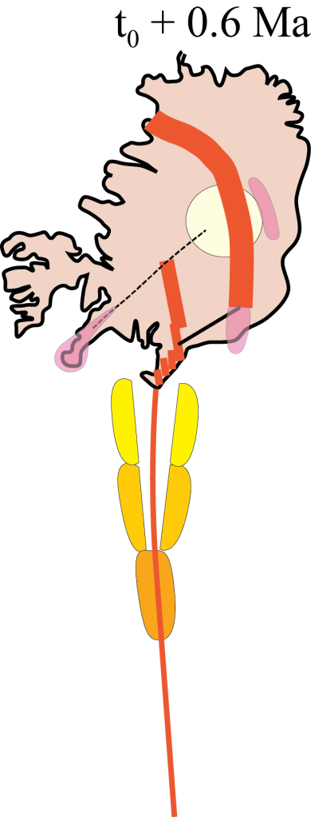
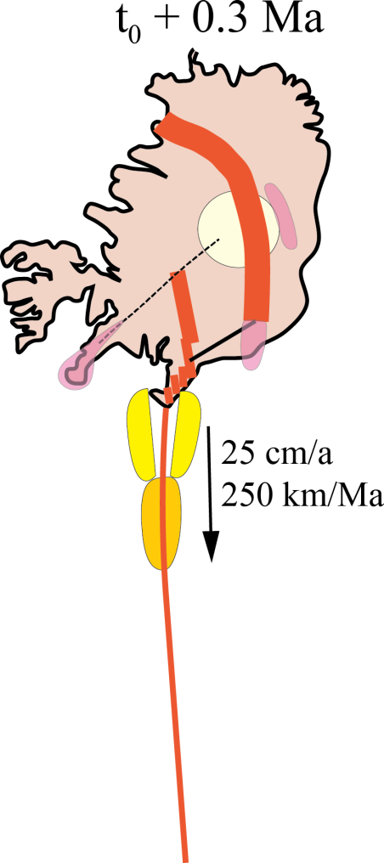
Diachronous V-shaped ridges record plume pulses

Slide 6
Lateral extent
RR: >1200 km KR: >900 km
(diameter: >2000 km)
Periodicity: 5-6 Ma in phase with uplift of Iceland plateau
and rift jumps in Iceland

Slide 7
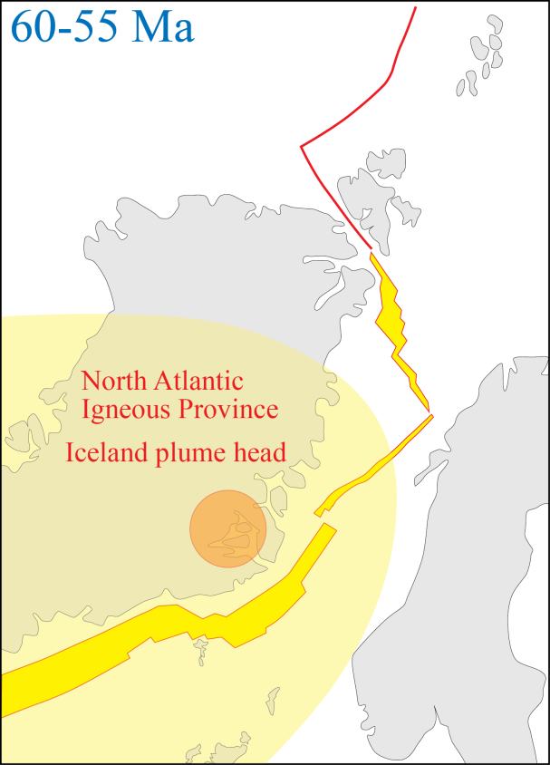
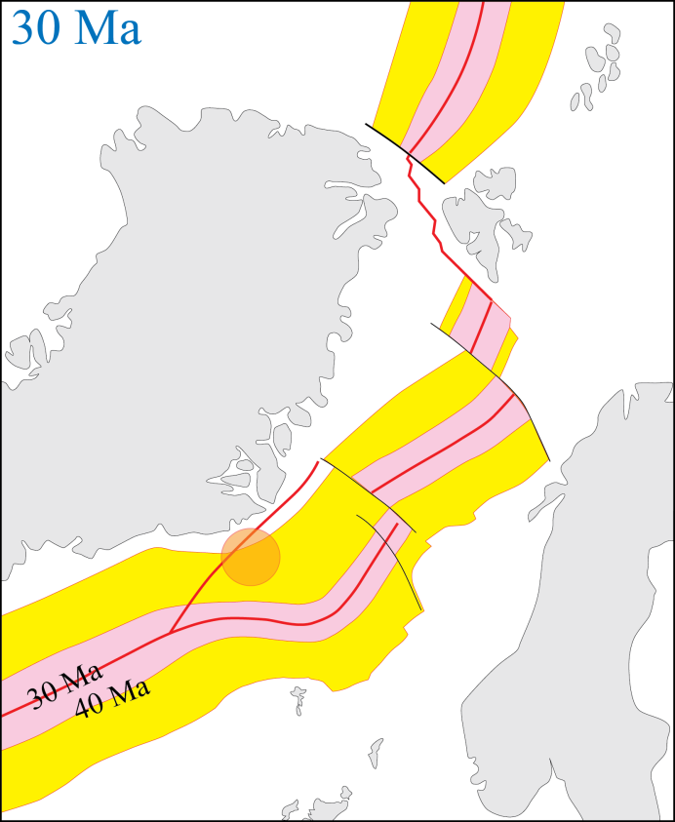
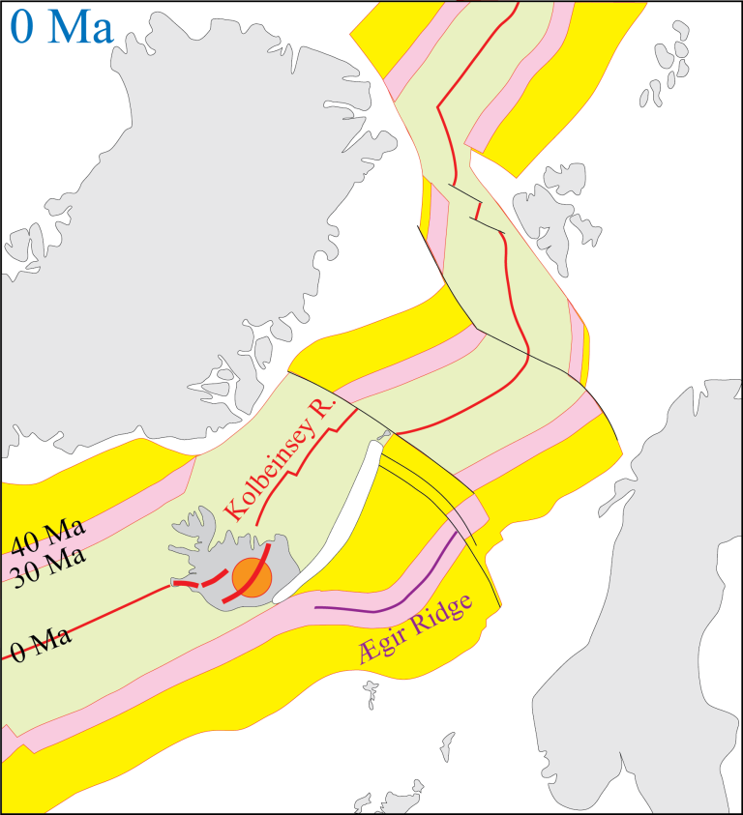
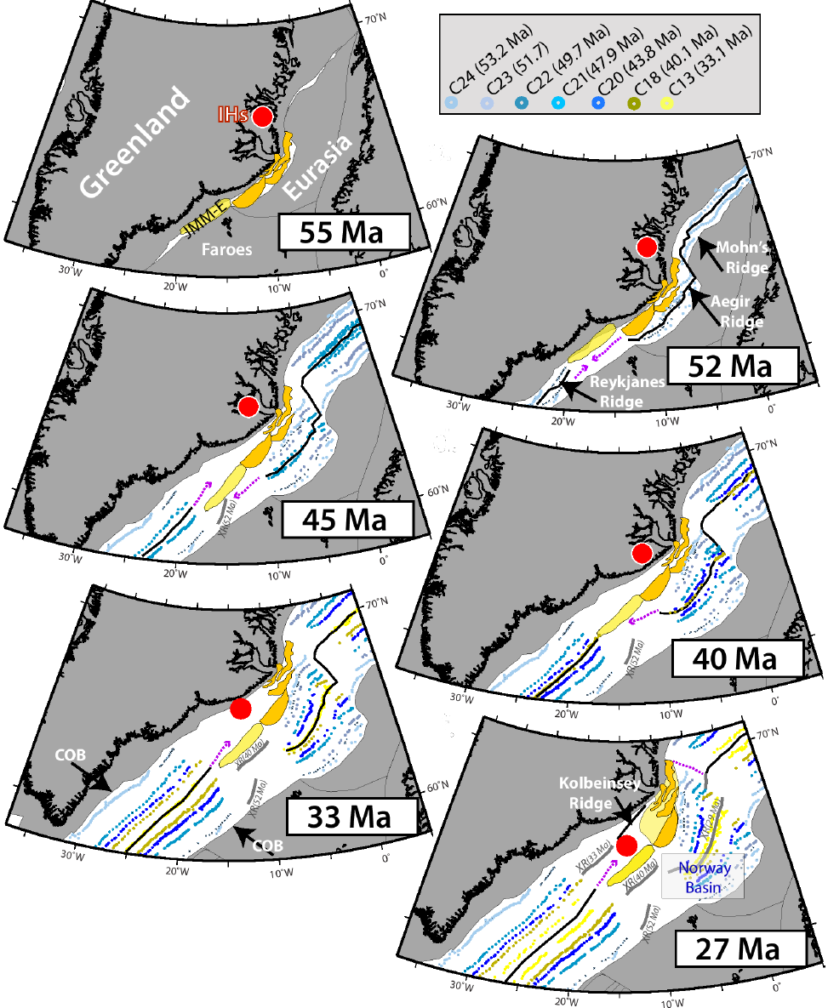
NE Atlantic evolution: simplified
C. Gaina (Torsvik et al., in rev, PNAS)

Slide 8
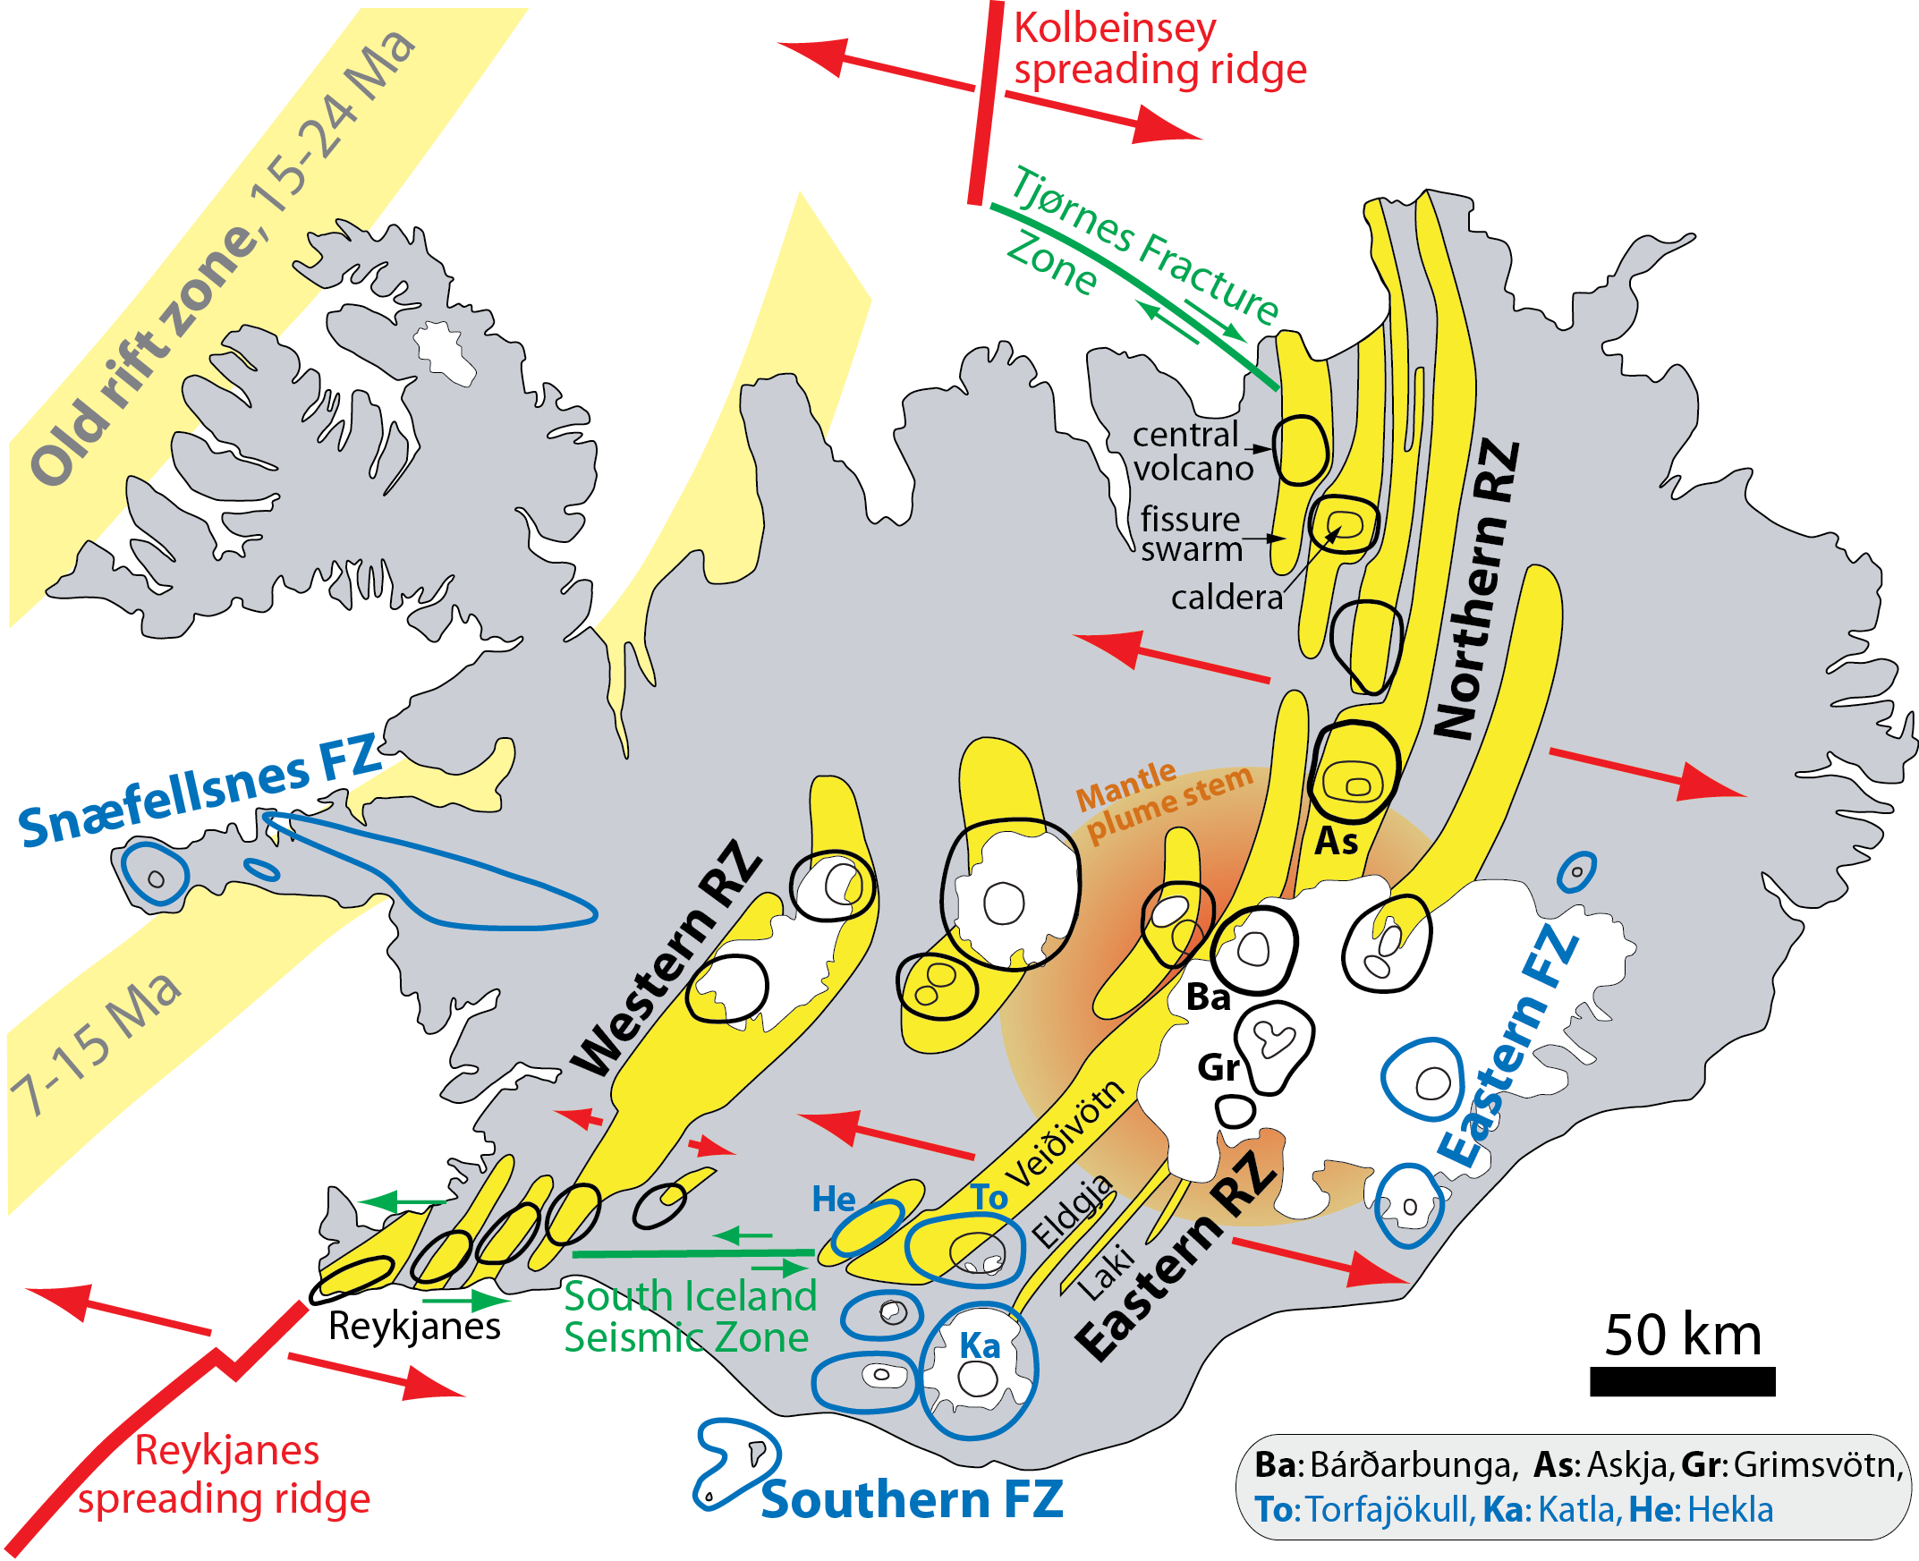
Volcanic systems, in the rift zones
fissure swarm + central volcano ± caldera
Regional stress field causes
change in the fissure swarm
direction in central Iceland
(Gudmundsson et al. 2014
NNE-trending
fissures
NE-trending
fissures

Slide 9
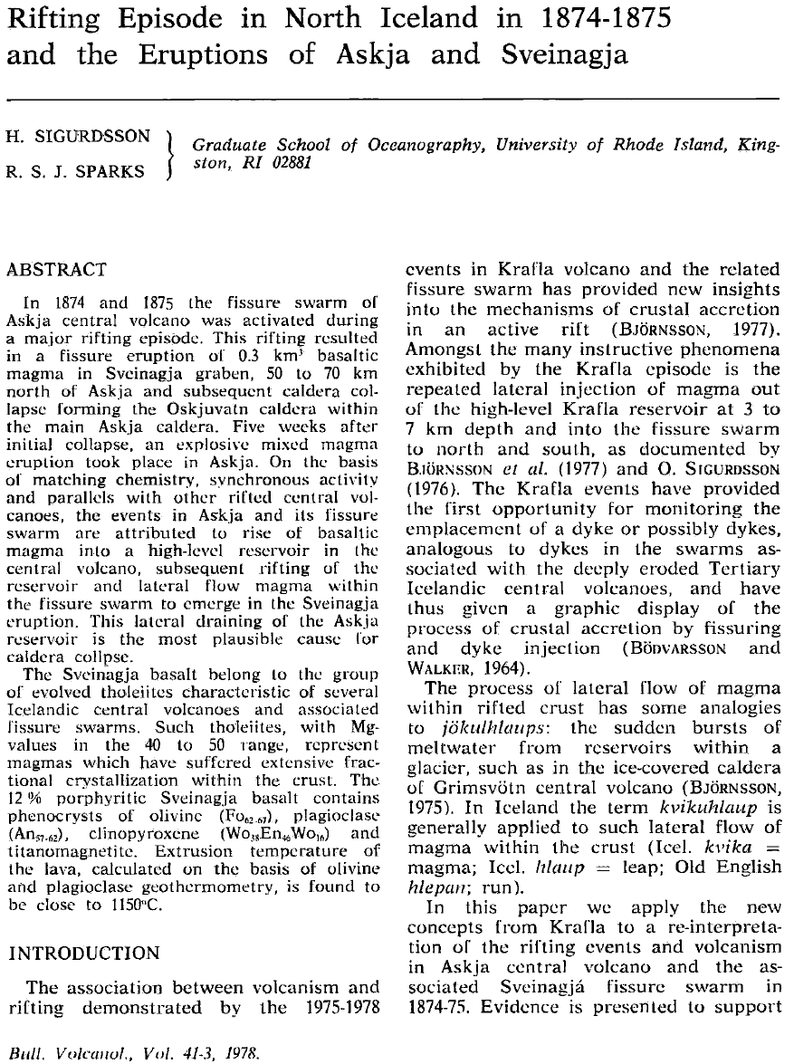
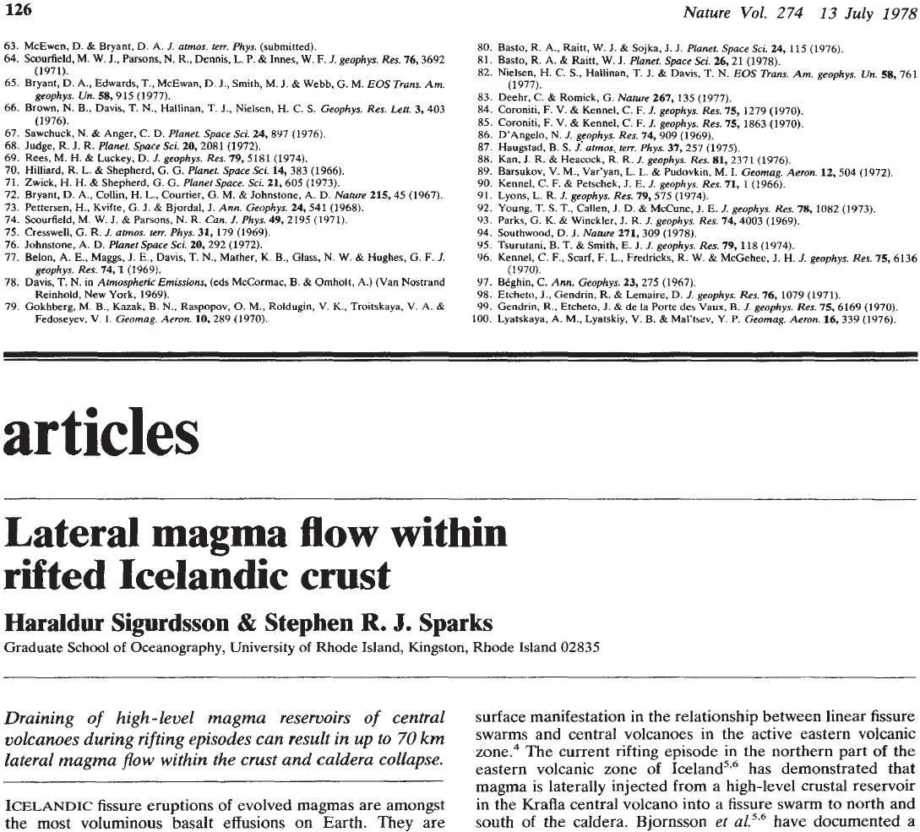
Magma flow along fissure systems in the Icelandic rift zones
- important during all rifting episodes and fissure eruptions
- lateral flow of up to 100-140 km

Slide 10
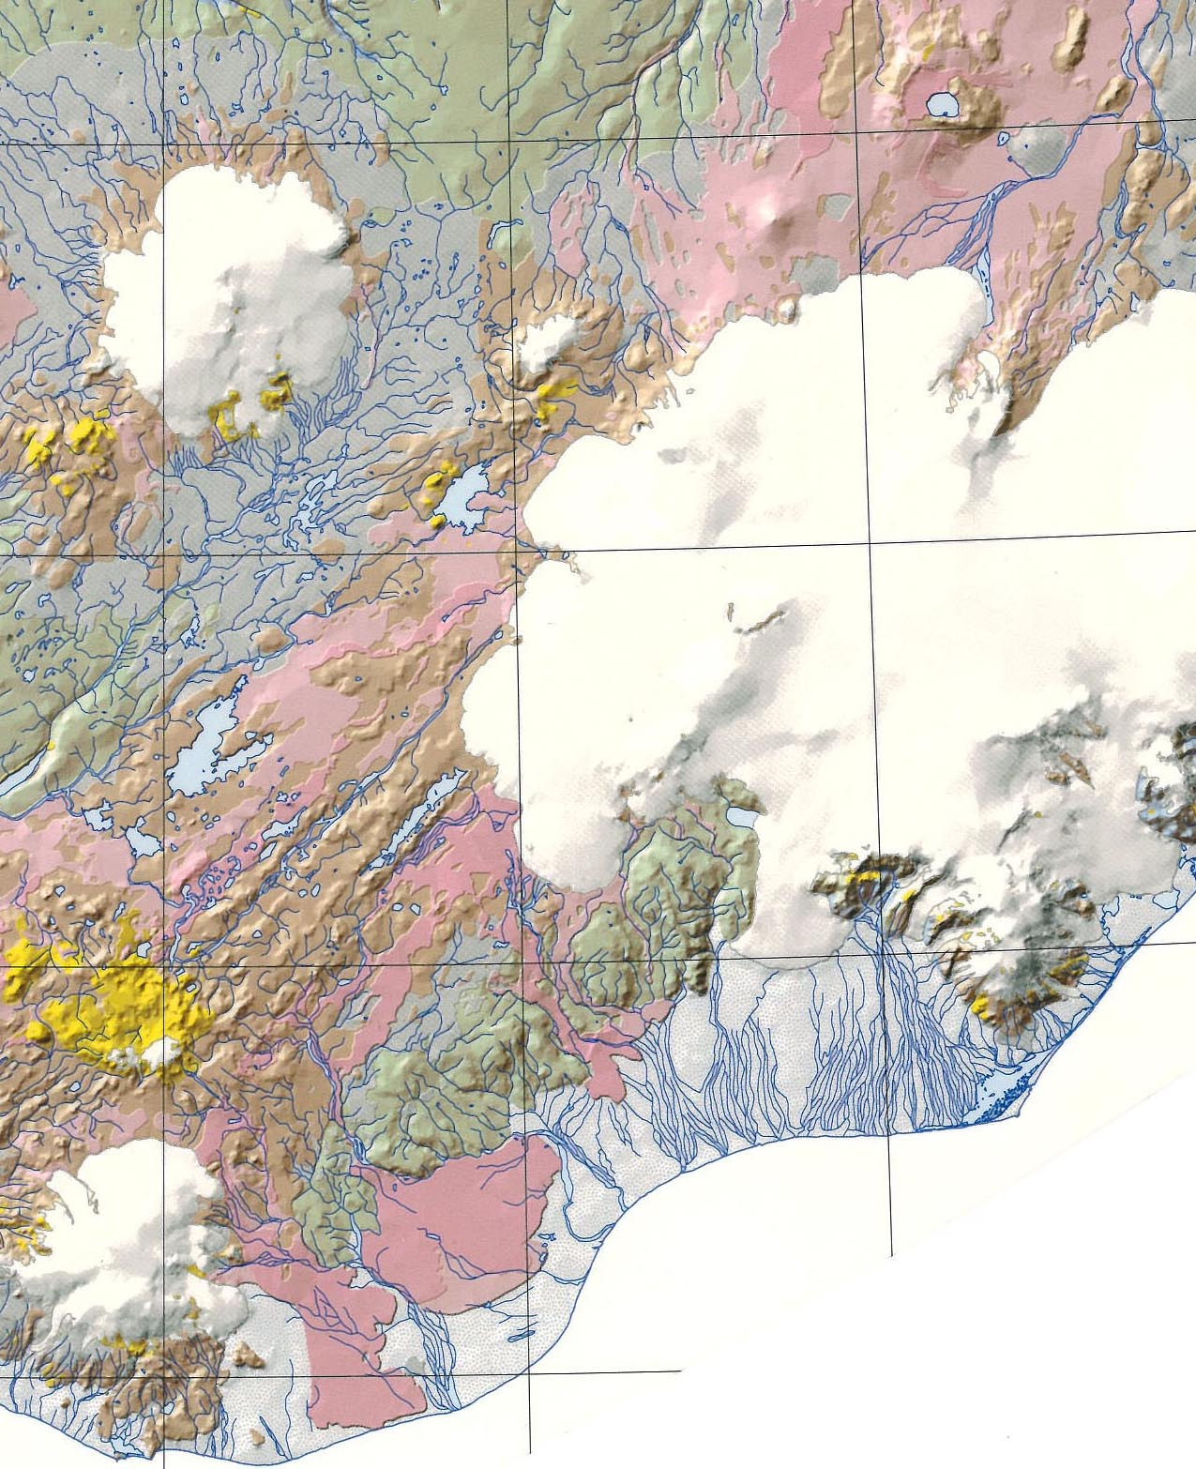
Bárðarbunga
Grimsvötn
Veiðivötn-Vatnaöldur fissure swarm
Laki, 1783-84,
15 km³
Eldgjá, 934-940,
20 km³
Torfajökull
Katla

Slide 11
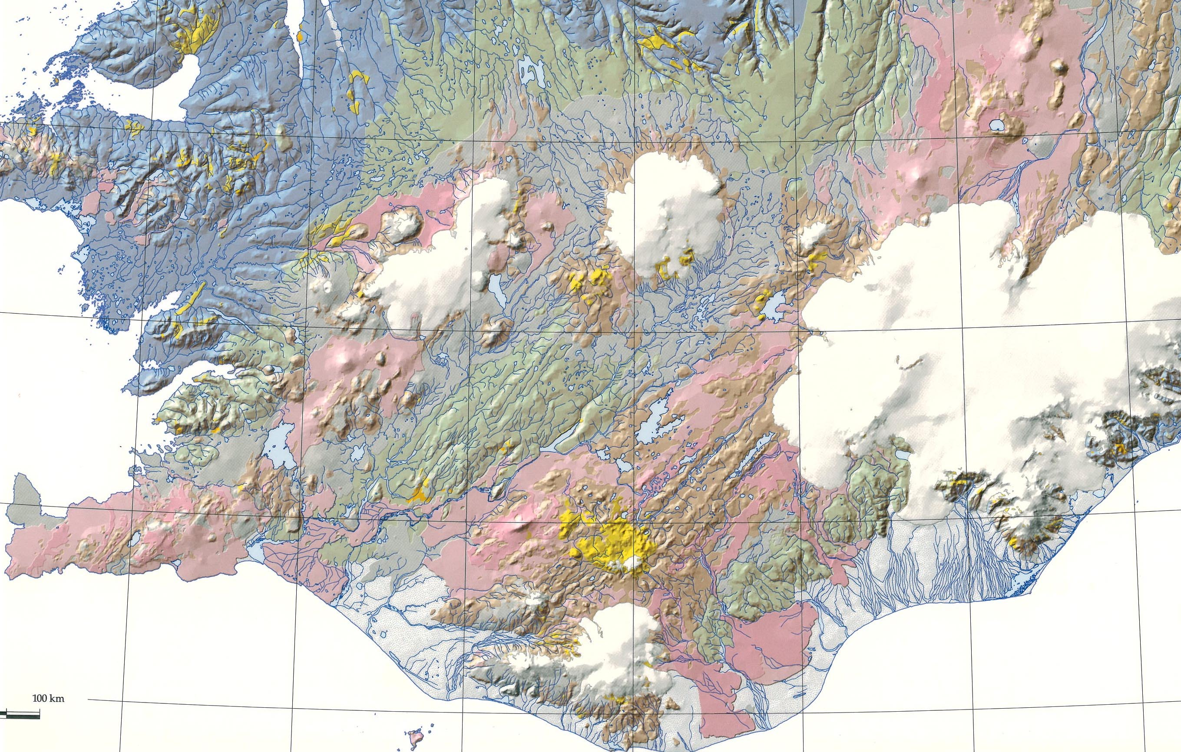
Bárðarbunga
Veiðivötn-Vatnaöldur fissure swarm
Torfajökull
Þjórsáhraun,
early Holocene, 25 km³

Slide 12
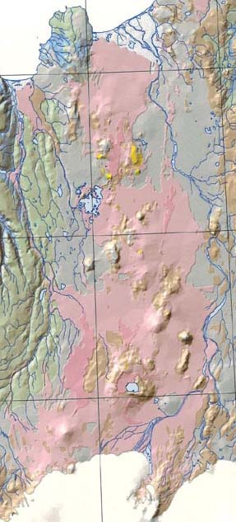
Bárðarbunga
Grimsvötn
Sveinagjá, 1875
Veiðivötn-Vatnaöldur fissure swarm
Laki, 1783-84,
15 km³
Eldgjá, 934-940,
20 km³
Askja
Torfajökull
Katla

Slide 13
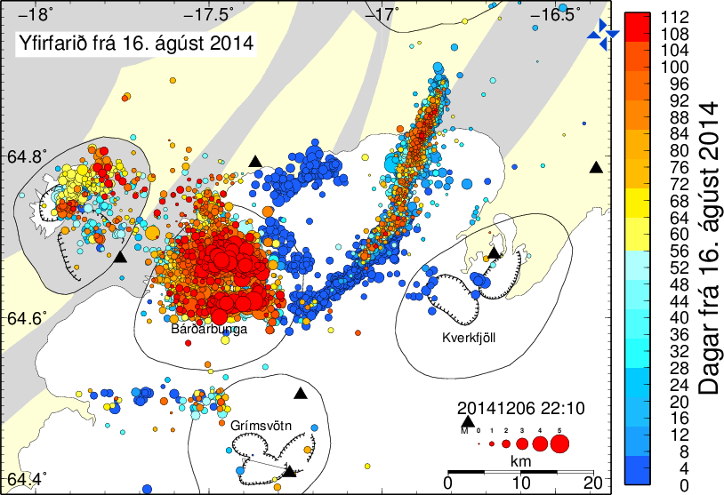
Accumulated earthquakes, Aug. 14 – Dec. 6 (112 days)
- large earthquakes (up to M5-M6) along the ring fault, Bárðarbunga caldera
- small eartquakes along the NE and NNE-striking dike

Slide 14
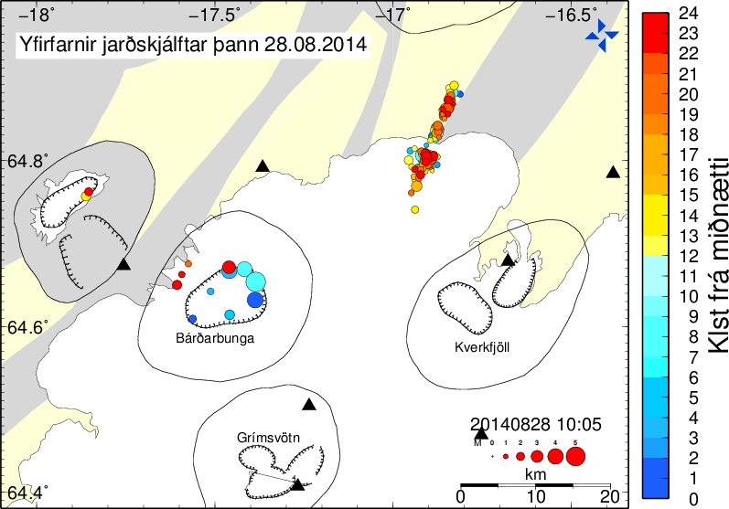
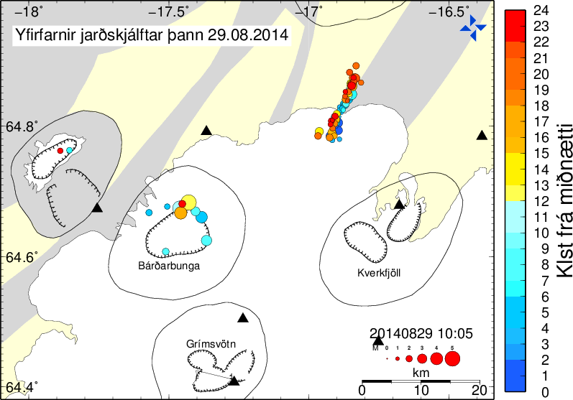
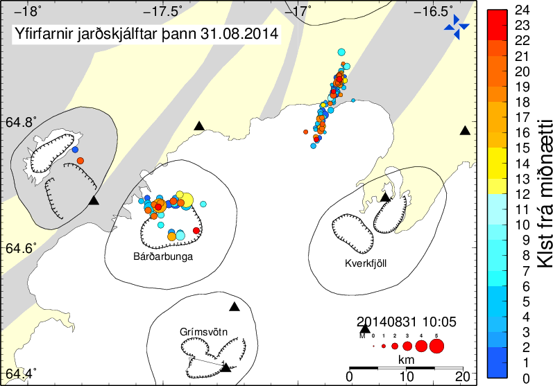
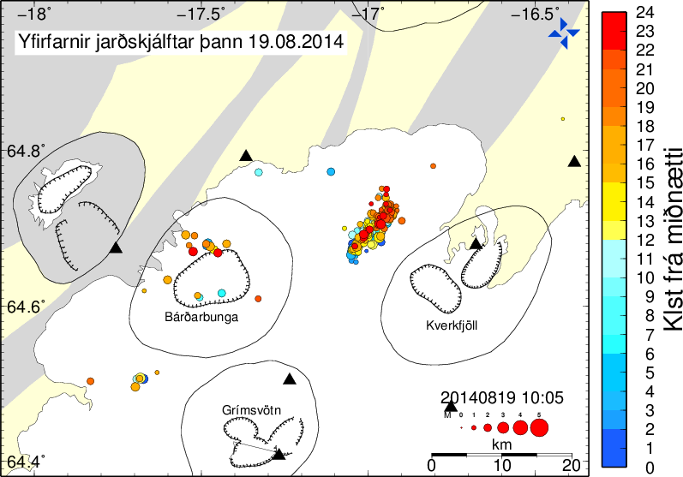
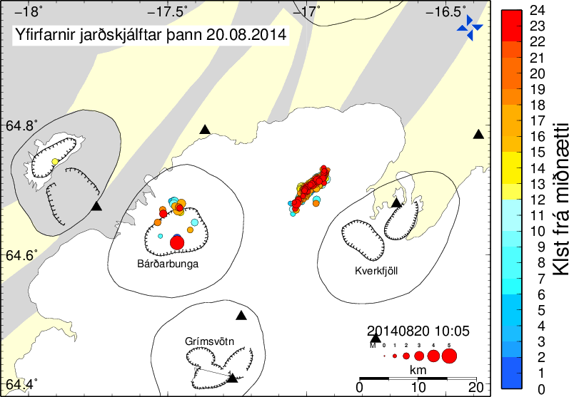
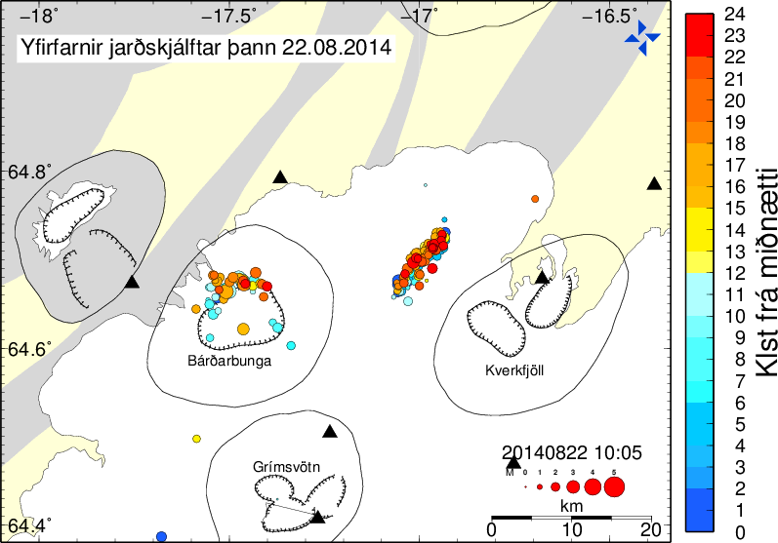
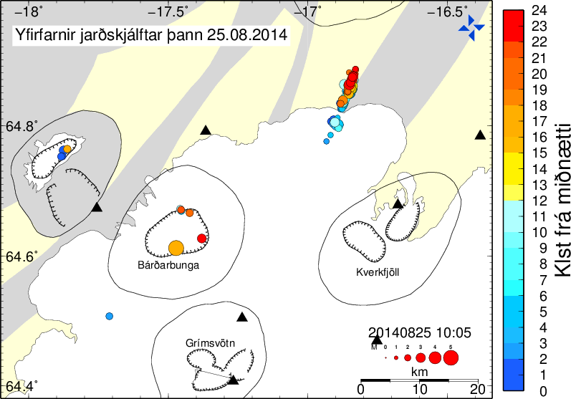
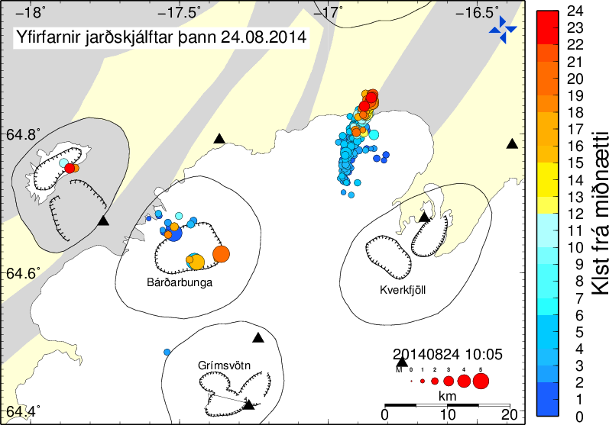
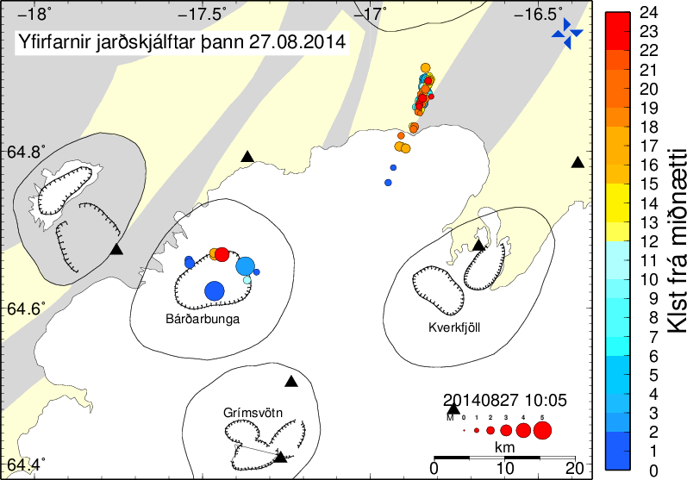
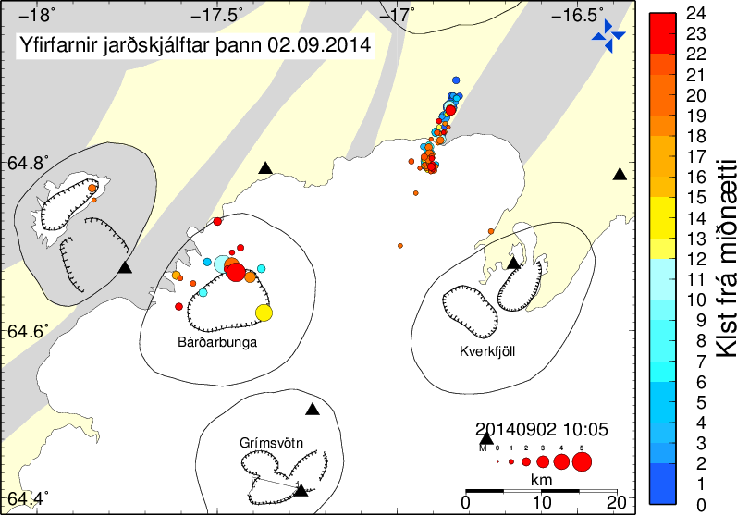
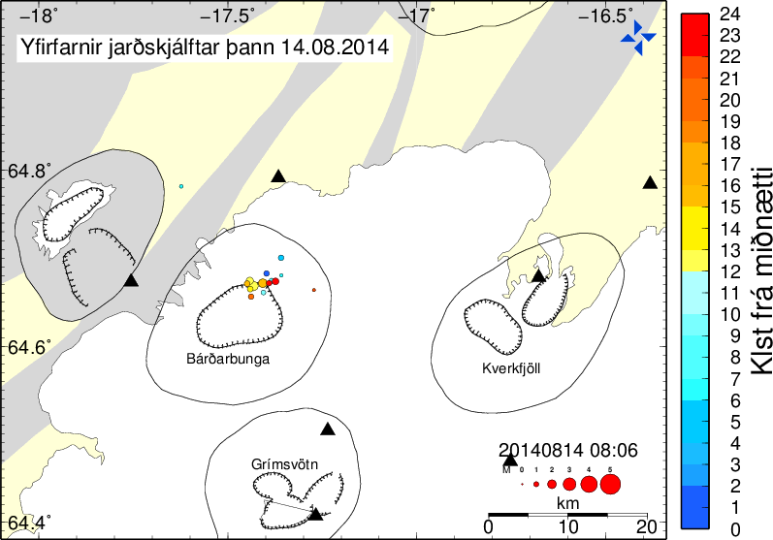
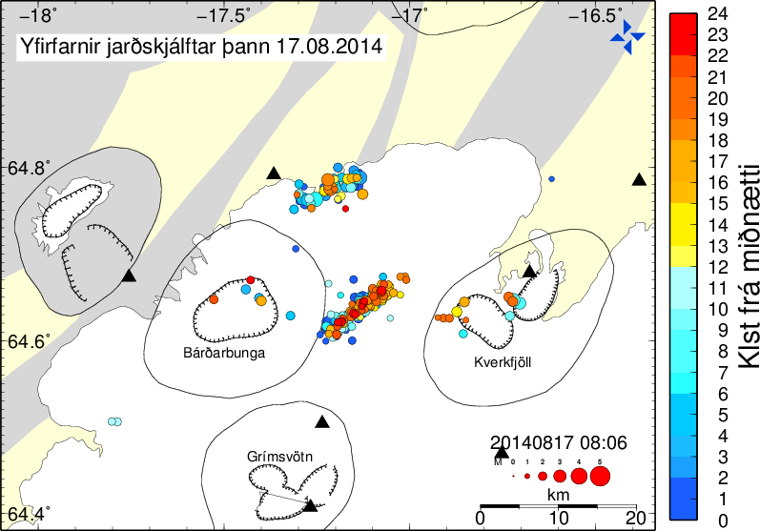
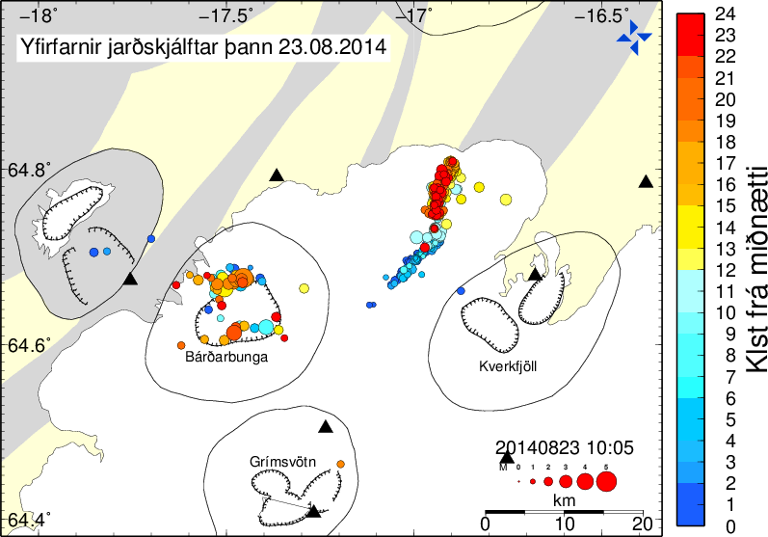
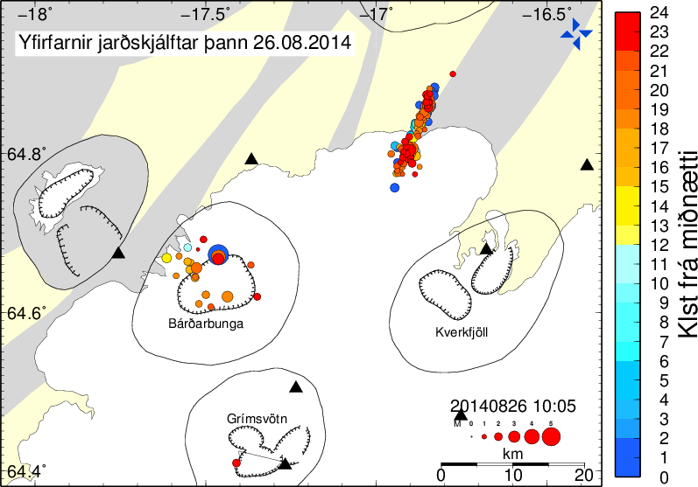
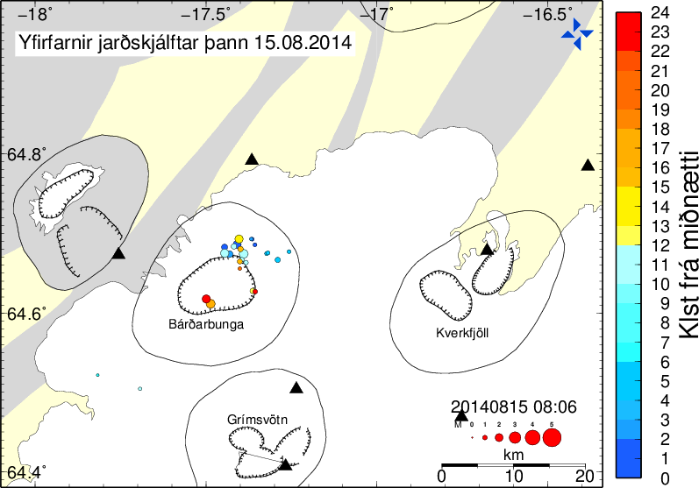
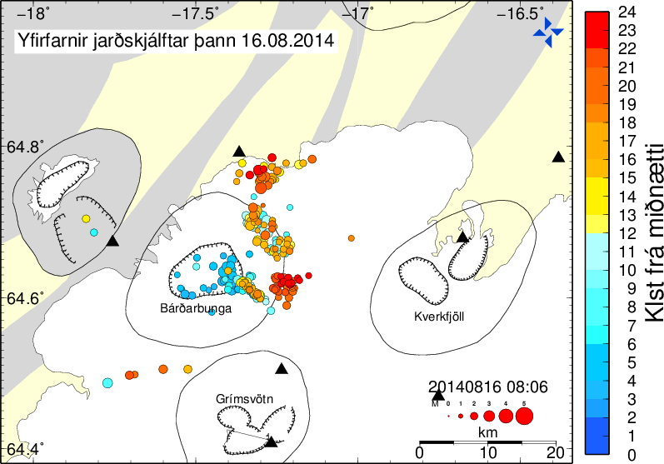
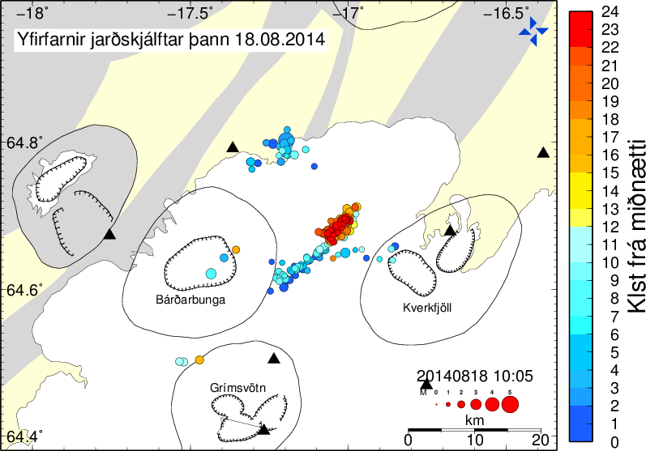
Collections of daily earthquakes, Aug. 14 –Sept. 2
magnitudes and locations
Time of day
11 pm
6 pm
6 am
1 am

Slide 15
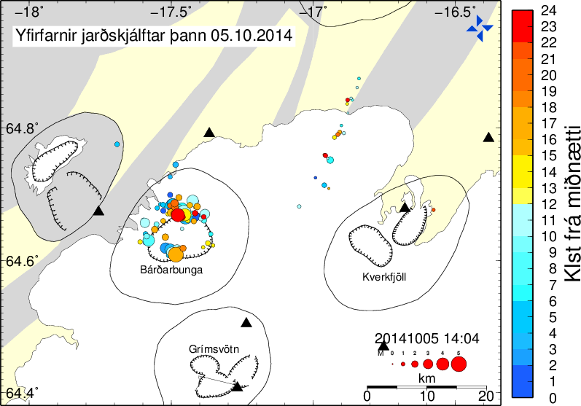
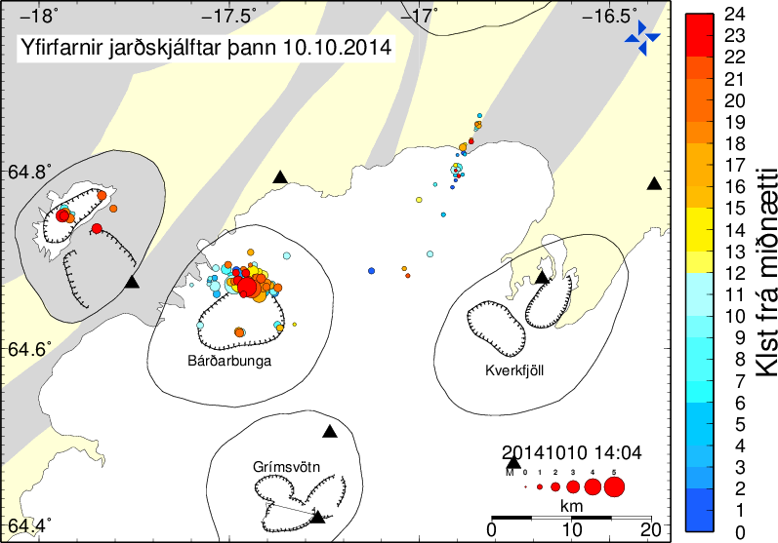
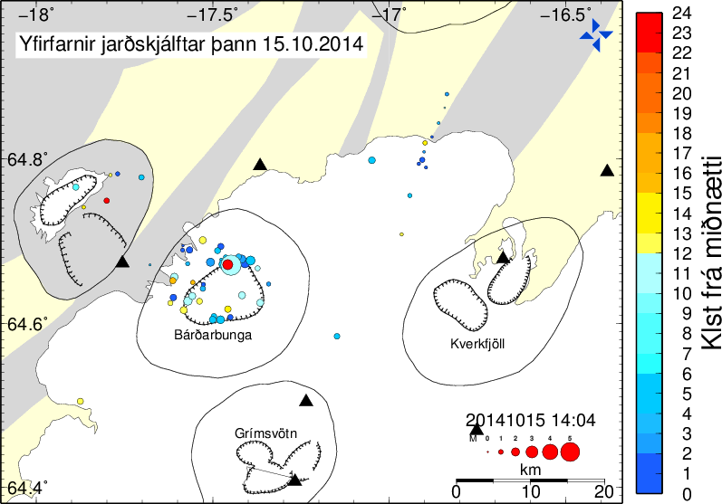
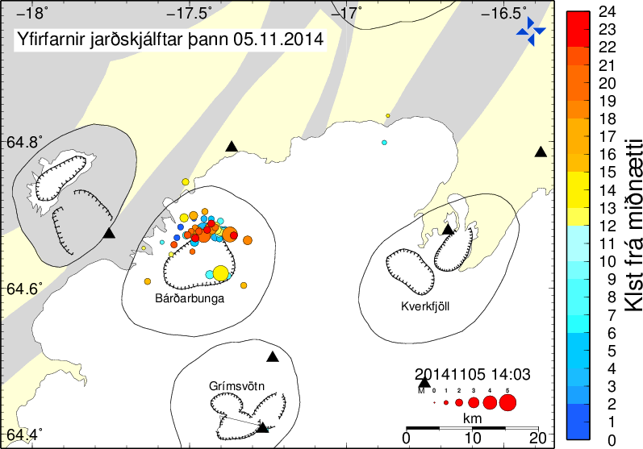
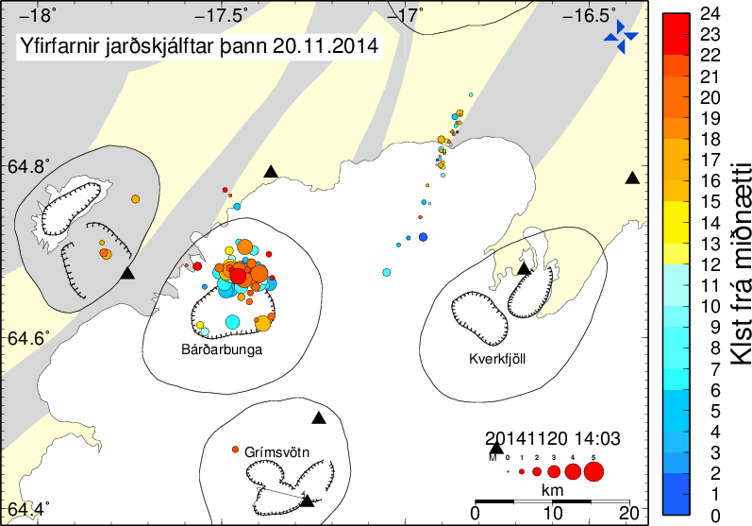
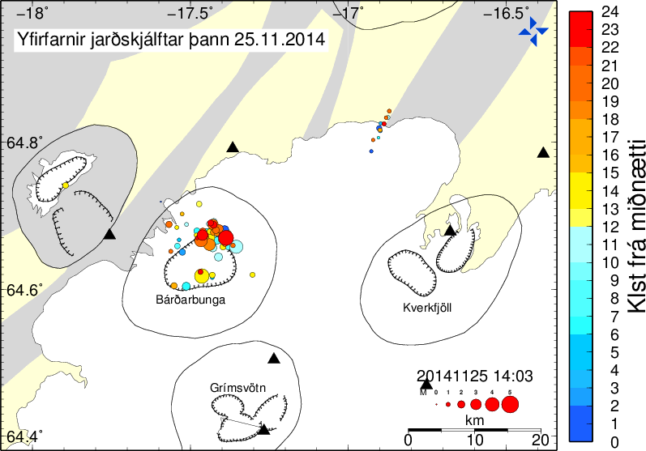
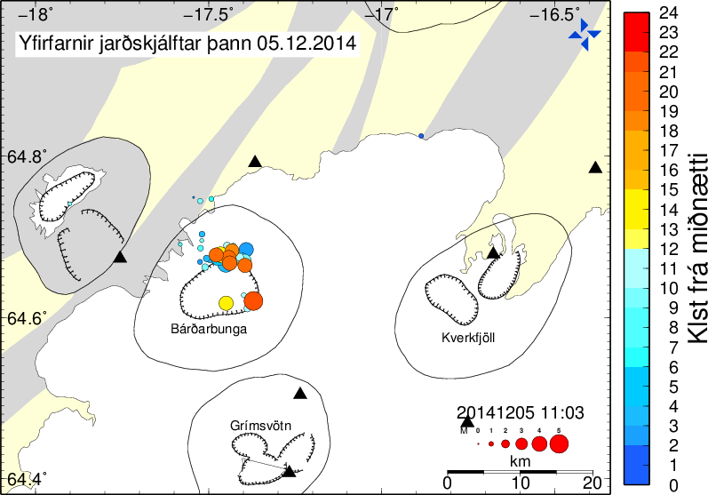
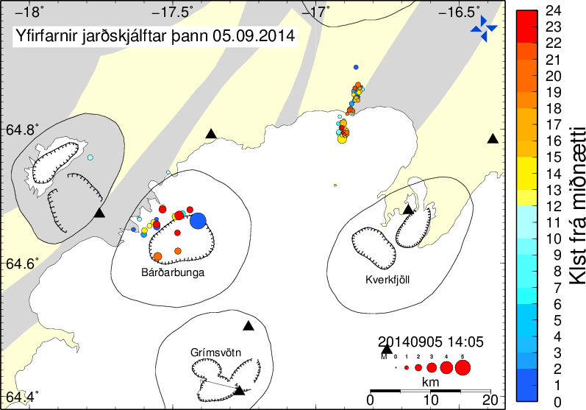
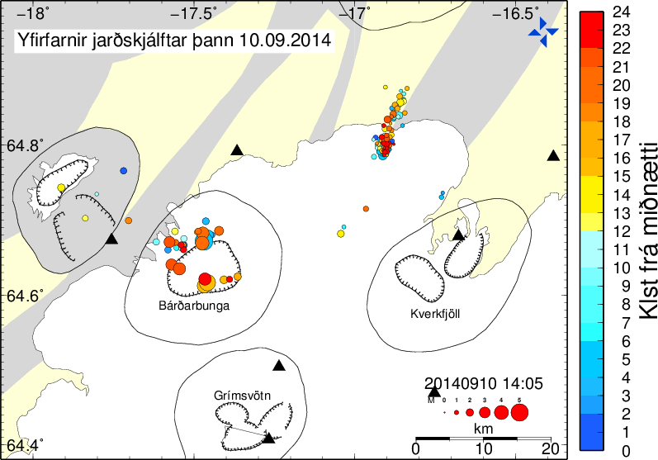
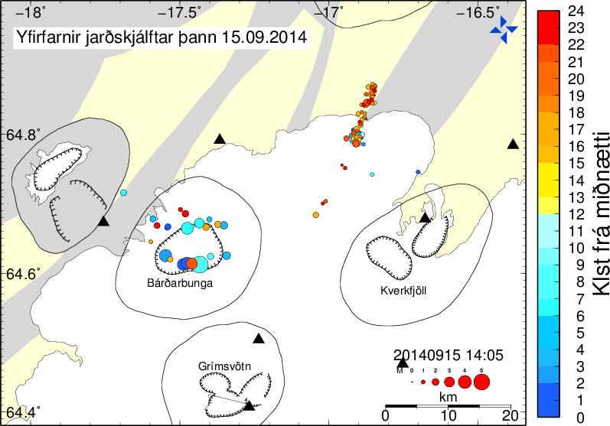
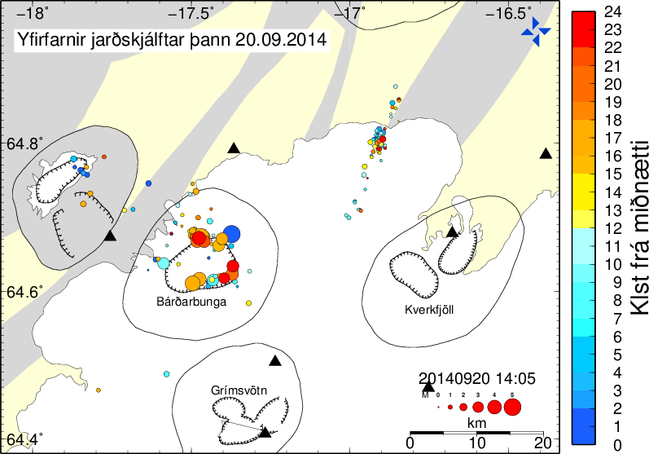
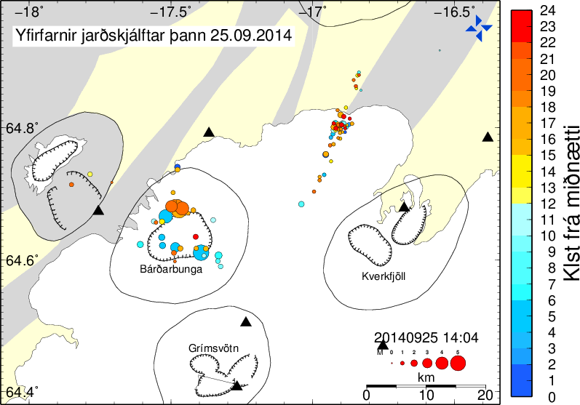
Collections of earthquakes, every fifth day, Sept. 5 – Dec. 5
magnitudes and locations
Subsidence of the
Bárðarbunga caldera
(60 km²)
NE part of the caldera:
Oct. 6: 30 m
Oct. 18: 35 m
Oct. 25: 40 m
Nov. 20: 45 m
Dec. 1: 50 m

Slide 16
Crustal deformation: 3-day and 1-day horizontal
movements, Aug. 26-27 and Aug. 24-27.
Arrows with error ellipses:
Green: 3-day displacement, Aug 24 to Aug 27
Red: 1-day displacement, Aug 26 to Aug 27
Aug. 28
Aug. 26
Aug. 24
Aug. 22
Aug. 20
Aug. 18
Aug. 16

Slide 17
Accumulated horizontal crustal movement, Aug. 14 − Dec. 7 (112 days)
VONC

Slide 18
Lava from 4 hr-eruption, Aug 29
Photos from Institute of Earth Sciences,
University of Iceland (Jarðvísindastofnun, Háskólans)
Askja central volcano
Aug 29 lava field
4 hr long euption
Vatnajökull (Dyngjujökull)
dark color is due to snow-free
and ash-laden ice

Slide 19
Lava from 4 hr eruption, Aug 29
Photos from Institute of Earth Sciences, University of Iceland (Jarðvísindastofnun, Háskólans)
Tugnafellsjökull
Hofsjökull
Bárðarbunga
Trölladyngja
Aug 29 lava

Slide 20
Lava from 4 hr-eruption, Aug 29 (on the Holohraun eruption from 1797)
Aug 29 lava

Slide 21
Lava from 4 hr eruption, Aug 29 (on Holohraun eruption, 1797)
1797-eruption
Holuhraun flow field
Aug 29 lava

Slide 22
Start of the main Nornahraun eruption, Aug 31
Photos from Institute of Earth Sciences, University of Iceland (Jarðvísindastofnun, Háskólans)

Slide 23
Start of the main eruption, Nornahraun, Aug 31
Photos from Institute of Earth Sciences, University of Iceland (Jarðvísindastofnun, Háskólans)

Slide 24
Peter Hartree, Sept. 4

Slide 25
Peter Hartree, Sept. 4

Slide 26
Peter Hartree, Sept. 4

Slide 27
Small satellite fissure eruption closer to Dyngjujökull (Nyja gossprungan), Sept. 5
View towards south, new fissure in the foreground, older eruption site further north - Askja central volcano (Dyngjufjöll) in the background Photo: Þóra Árnadóttir, Institute of Earth Sciences, University of Iceland (Jarðvísindastofnun, Háskólans)

Slide 28
New eruption fissure (Nyja gossprungan), Sept. 5
Photo: Þóra Árnadóttir, Institute of Earth Sciences, University of Iceland (Jarðvísindastofnun, Háskólans)

Slide 29
Sept. 10: Suðri crater with its lava, flowing soutwards
Photo: Morgan Jones, Centre for Earth Evolution and Dynamics, University of Oslo

Slide 30
Sept. 10: Suðri crater with its lava, flowing soutwards
Photo: Morgan Jones, Centre for Earth Evolution and Dynamics, University of Oslo

Slide 31
Sept.10: new NNE-trending graben under and north of Dyngjujökull, 600-800 m wide, 6 km long parallel to the fissure swarm. Looking north. Photo: Morgan Jones, CEED (note the shadow of Morgan's helicopter)

Slide 32
Western margin of the graben, looking south. Estimated subsidence along the normal fault is about 8 m (Sept. 5)
Photo: Jónas Guðnason, Institute of Earth Sciences, University of Iceland (Jarðvísindastofnun, Háskólans)

Slide 33
Radar image, Sept.1 (from the Coast Guard aircraft), showing a new 700-100 m wide, 6 km long NNE-trending graben along the fissure swarm.

Slide 35
Development of northern lava flow during the first 7 days (Aug. 31-Sept.6):
That single flow, currently (Aug. 6) extends 11.5 km northeastwards, parallel to the western Jökulsá tributary. It is now about 75% of the total length of the Photo: Þóra Árnadóttir, Institute of Earth Sciences, University of Iceland (Jarðvísindastofnun, Háskólans)

Slide 36
Sept. 12
Norðri
Baugsbörn
Baugur
Suðri
Nyja gossprungan

Slide 37
Oct. 17

Slide 38
Oct. 19-23

Slide 39
Oct. 24 (thermal imaging, using Landsat 8)

Slide 40
Dec. 1 (thermal imaging, using Landsat 8)

Slide 41
Status, early December:
- Dec. 8: exactly 100 days of steady, vigorous eruption (possibly in weak decline in Dec.)
- volume of erupted magma: >1.4 km³ (largest eruption since Laki, 1783-84)
early reports of 0.02 km³/day: 2.0 km³, Dec. 8
(possibly forth largest in historic times: Hallmundarhraun 900, 9 km³, Eldgjá, 934-40, 20 km³ and Laki)
The Bárðarbunga-Nornahraun eruption may be related to incremental decompression melting in the mantle due to the accelerated decrease of the Vatnajökull ice mass

Slide 42
http://en.vedur.is/
http://www.ruv.is/volcano

Slide 43
November 26 - Tobias Dürig

Slide 44
Sept. 12:
Suðri, Baugur and Baugsbörn craters
Photo: Ármann Höskuldsson, Institute of Earth Sciences, University of Iceland (Jarðvísindastofnun, Háskólans)
Baugsbörn
Baugur
Suðri
Baugur
Suðri
Baugsbörn

Slide 45
20,000 earthquakes in one month
Fyrst birt: 16.09.2014 20:11, Síðast uppfært: 16.09.2014 20:14
Tuesday marks one month since a record wave of seismic activity started at and around the volcano of Bardarbunga. At least 20,000 earthquakes struck the area in that period, according to estimates from the Icelandic Met Office. 186 earthquakes of magnitude 3.0-3.9 were detected. 43 quakes were of magnitude 4.0-4.9, most of them at Bardarbunga's caldera. A total of 23 earthquakes were detected of magnitude 5.0 or greater, all at Bardarbunga. The largest earthquake, a magnitude 5.7, struck on 26 August. That's the largest earthquake in Iceland since a M6.3 struck east of Reykjavík in 2008.
No significant changes have been observed in the ongoing lava eruption at the lava field of Holuhraun, north of Bardarbunga volcano. Sulfur dioxide pollution from the eruption continues to plague people in the northern and eastern parts of Iceland, though it causes no immediate harm to people.
A M5.2 earthquake struck Bardarbunga Tuesday afternoon. The subglacial volcano's caldera continues to subside at a rate of 50 cm (20 inches) a day, according to scientists.
Winter arrives at Holuhraun
Fyrst birt: 29.09.2014 12:04, Síðast uppfært: 29.09.2014 12:04
A month has now passed since the Holuhraun lava eruption began. Winter has now arrived in the Icelandic highland, putting the new lava in stark contrast. The effusive eruption is becoming one the largest in Iceland in recent decades; only the Hekla eruption 1947-48 produced more lava.
According to estimates made two days ago, the new lava field has reached 44 square kilometers and its volume was believed to be at least 0.6 cubic kilometers. The eruption has been relatively steady from the beginning and show no signs of being in decline.
The Holuhraun eruption is now among the largest one in Iceland for the last 150 years. According to geophysicist Magnus Tumi Gudmundsson at the Univ. of Iceland´s Institute of Earth Sciences, only the Hekla eruption in 1947-48 produced more lava, during the 13 month eruption. That created 0.8 cubic kilometers of lava; should the Holuhraun eruption continue with the same intensity as before, that milestone could be reached in about 2 weeks.
Seismic activity in Bardarbunga caldera continues at a similar rate as previous days, according to a status report published this morning, and GPS measurements show continuing slow movements. "Six earthquakes bigger then M3,0 were recorded since noon yesterday. The biggest one was M5,2 at 12:34 yesterday. Smaller earthquakes were detected in north part of the dyke and around the eruption site."
bjornm@ruv.is
Caldera area: long, short and intermediate diameter: 10.5, 7 and 8.75 km. A= 3.14*(4.375)² = 60 km²
Oct. 6: Eruption continues unabated. Current state of caldera floor subsidence: 30 m → V = 60 km² * 0.03 km = 1.8 km³/37 days = 0.049 km³/day
Oct. 18: Eruption continues unabated. Current state of caldera floor subsidence: 35 m → V = 60 km² * 0.035 km = 2.1 km³/49 days = 0.043 km³/day
Oct. 25: Eruption continues unabated. Current state of caldera floor subsidence: 35 m → V = 60 km² * 0.040 km = 2.4 km³/56 days = 0.043 km³/day
Main eruption start: Aug. 31.
Sept. 29 (30 days later): lava volume estimate: > 0.6 km³. Daily lava production 0.6/30 = 0.02 km³.
Projection: Oct. 9 (40 days): > 0.8 km³, exceeding the 13-month long Hekla 1947-48 lava production. V(Bard-caldera): 2.6
Oct. 13 (44 days): > 0.88 km³, exceeding the 13-month long Hekla 1947-48 lava + tephra(DRE) production. V(Bard-caldera): 2.9
Oct. 19 (50 days): > 1.0 km³, exceeding the 24-day long Katla 1918 lava + tephra(DRE) production. V(Bard-caldera): 2.8
Oct. 30 (61 days): > 1.22
Nov. 13 (75 days): > 1.5 km³, exceeding the 2-year long Hekla 1766-68 lava + tephra(DRE) production. V(Bard-caldera): 4.8

Slide 46
Icelandic rift zones: RZ and
volcanic flank zones: VFZ / FZ
Jan Mayen Ridge: Trail of continental slivers
extending under SE Iceland (Torsvik et al., submitted)

